Slide 1
Travel assistant ai agent
CAPSTONE PROJECT
Presented By:
Student name :V.Gayathri
College Name & Department :Mepco Schlenk Engineering College, Computer Applications

Slide 2
OUTLINE
Problem Statement
Technology used
Wow factor
End users
Result
Conclusion
Git-hub Link
Future scope
IBM Certifications

Slide 3
Problem Statement
A Travel Planner Agent is an AI-powered assistant that helps users plan trips efficiently and intelligently. It uses real-time data to suggest destinations, build itineraries, and recommend transport and accommodation options This smart assistant transforms complex travel planning into a seamless, enjoyable process.
Proposed Solution: An AI-powered Travel Planner Agent using IBM Watsonx.ai Granite models in Watson Studio, which collects user preferences and generates personalized travel plans. The agent performs destination recommendations, transport and accommodation suggestions, itinerary planning, and weather forecasting, all integrated into a single intelligent workflow.

Slide 4
Technology used
IBM cloud lite services
Natural Language Processing (NLP)
Prompt Engineering
IBM Granite model

Slide 5
IBM cloud services used
IBM Cloud Watsonx AI Studio
IBM Cloud Watsonx AI runtime
IBM Cloud Agent Lab
IBM Granite foundation model

Slide 6
Wow factors
This agent will significantly reduce travel planning time, enhance the quality of trip decisions, assist first-time travelers in making informed choices, and encourage exploration by making travel information more personalized and actionable.
Unique features:
Smart destination recommendations based on user preferences, budget, and travel season
Auto-generated itineraries with daily activity suggestions
Transport and accommodation planning optimized for cost and convenience
Real-time weather insights for chosen destinations
Budget-aware trip planning with detailed cost breakdowns
Personalized alerts and updates (e.g., travel advisories, seasonal highlights)

Slide 7
End users
Travelers,
Tourists
Family Vacationers
Travel Agents
Students
Corporate Travelers

Slide 8
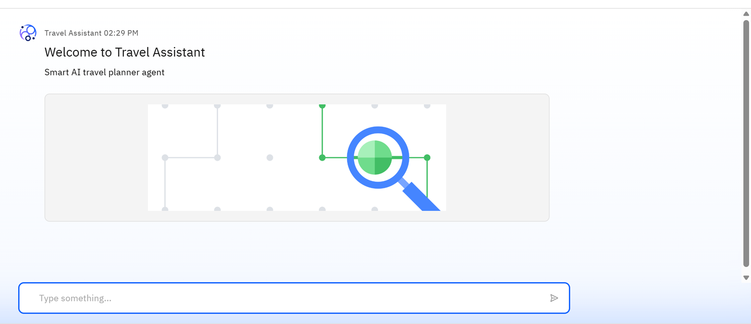
Results

Slide 9
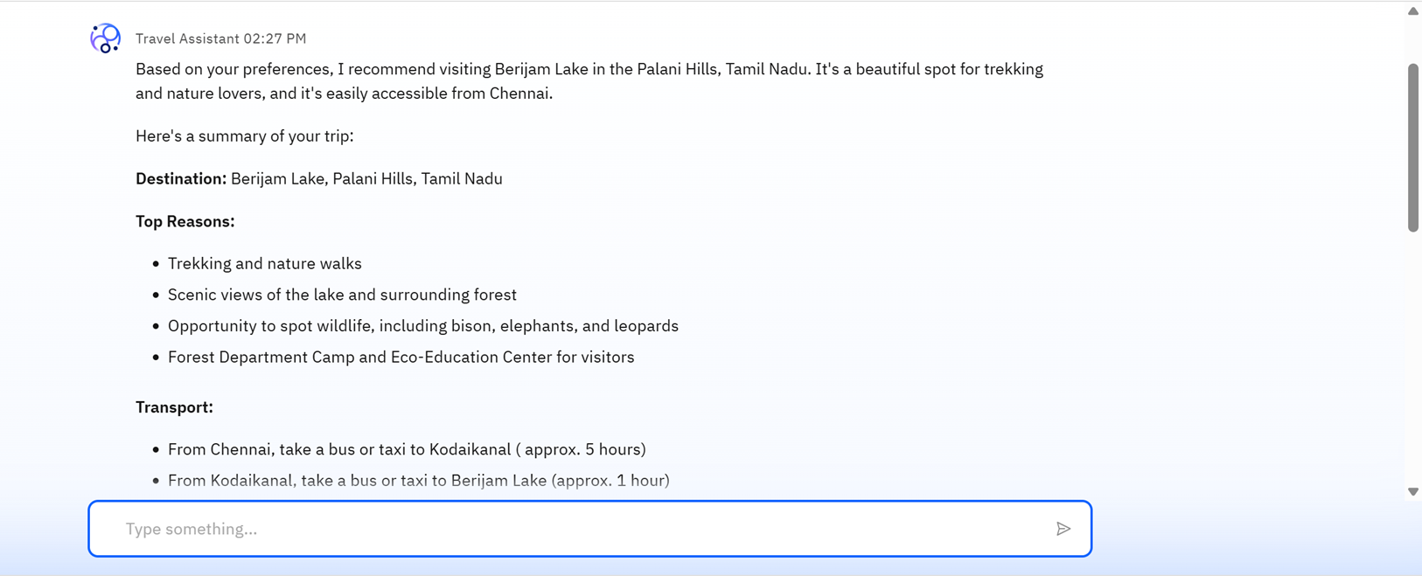
Results

Slide 10
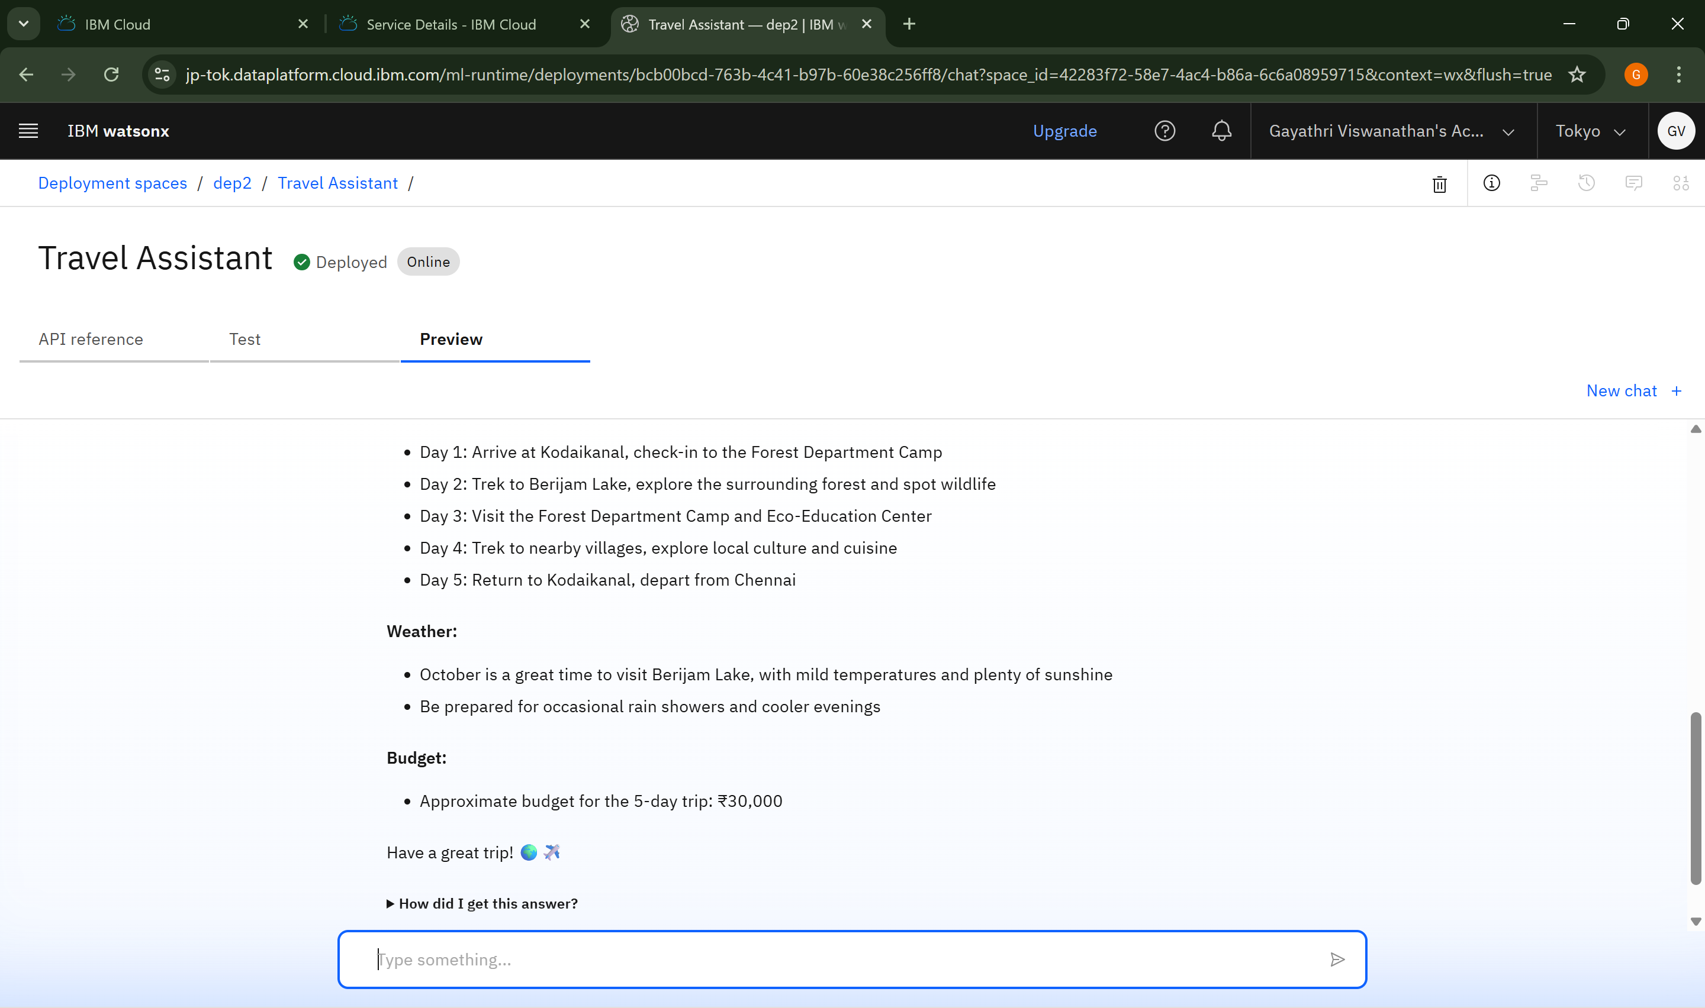
Results
Deployed AI Agent

Slide 11
Conclusion
The Travel Planner Agent simplifies and automates the entire trip planning process, making travel more accessible and stress-free.
It leverages IBM Watsonx.ai and Granite models to deliver personalized, real-time recommendations for destinations, transport, stay, and activities.
This intelligent assistant enhances user experience by reducing manual effort, ensuring cost-effective planning, and providing smart, data-driven travel insights.

Slide 12
GitHub Link
https://github.com/Gayathri-2510/Travel-Assistant-AI-Agent

Slide 13
Future scope
Voice-based travel planning
Real-time booking integration
Multilingual support
Dynamic itinerary updates
Integration with AR/VR for virtual previews

Slide 14
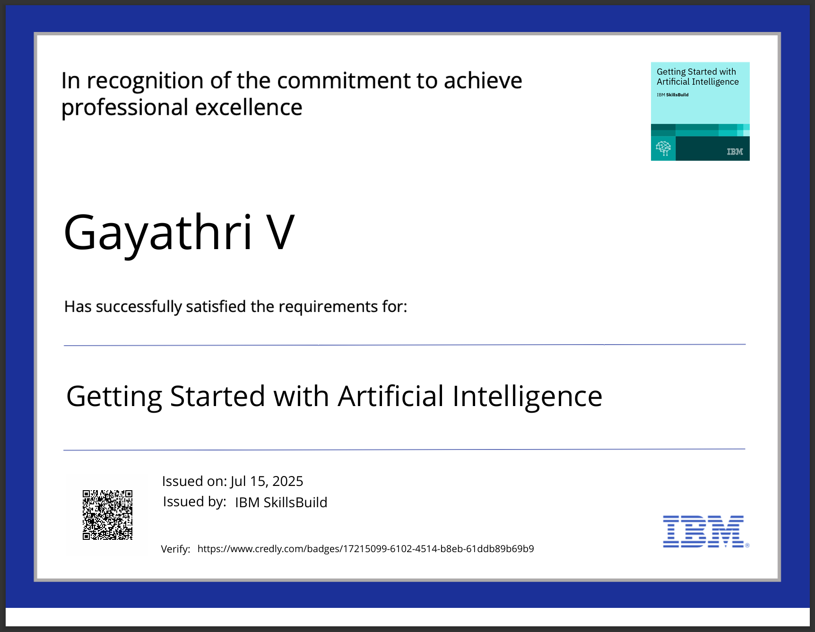
IBM Certifications

Slide 15
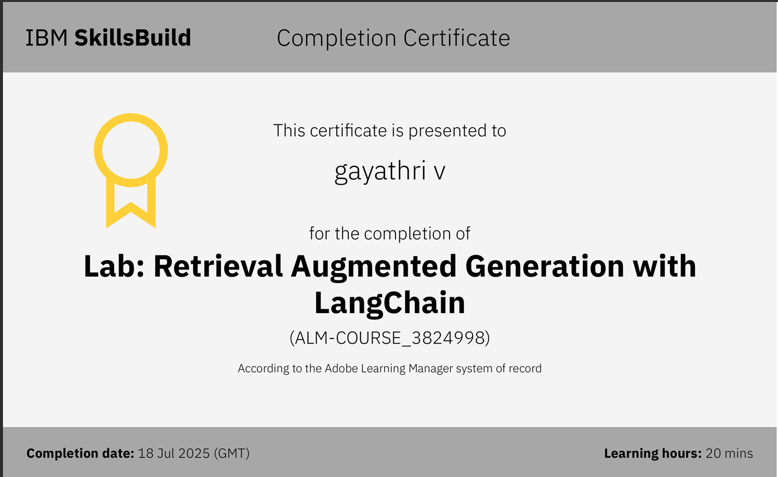

Slide 16
THANK YOU

